Slide 1
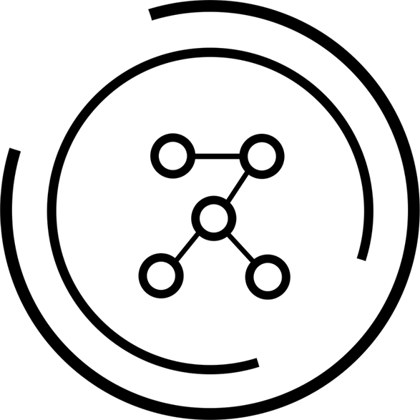

Petition Data Analysis
DSS x Change.org
Notes:
PMs

Slide 2


Data Science Society at UC Berkeley
Notes:
Nikki
Data Science Society is Berkeley’s first data science student organization and was founded in 2016, years before the data science major here was created. Back then, our club actually took part in creating the data science curriculum for the data science major. Now, our organization, hosts events like our annual datathon and speaker panels to make data science and its many applications accessible to everyone. We teach a class where we teach the basics of data science and walk students through their first real-world data science project. We are from the Social Good committee, which aims to do social good work primarily through data science consulting for nonprofits and social impact companies. In the past, we’ve worked with organizations like The Nature Conservancy, American Red Cross,

Slide 3


Project Managers
Nikki Trueblood
Natraj Vairavan
Notes:
PMs

Slide 4





Data Consultants
Kristen Vitolo
Preetha Kumar
Vikash Giritharan
Sooyeon Kim
Pujitha Nachuri
Notes:
Consultants

Slide 5
Agenda
01
Background
02
Petition Analysis
Harmful Data
Challenges + Future Work
03
04
Notes:
Natraj

Slide 6
01
Background
Notes:
Natraj

Slide 7
Our Tasks
Analyze Petitions
Predict Success
Examine Harmful Data
Find factors that contribute to petition growth/signatures
Use features to build a model that can predict a petition’s # of signatures
Investigate patterns in harmful/spam petitions to improve content regulation
Background
Petition Analysis
Harmful Data
Challenges/Future Work
Notes:
Natraj
Outline:
KV + PK + VG:
1. 90th Percentile Metric [DA]
2. Polarity Scores and Sentiment Analysis [DA]
- Description and Title
3. Frequency Table of Common Words [DA]
4. WordCloud with Common Words [DA]
5. Feature Engineering ~ one hot encoding, length of description, sentiment, what works [M] [C]
6. Yake to Extract Most Important Words on Description (similar to WordCloud) [M]
7. Yake for Staff/User Tags [M]
8. Modeling to Predict signs_30d [M] [C]
- Linear Regression
- Poisson Regression
- Negative Binomial Regression
Harmful Data
General research on harmful data, approaching this (1.5 min)
EDA on harmful data
Challenges with harmful data
Perspective API (3 min)
Challenges with getting Perspective to work
Toxicity score visualization
Profanity visualizations (2 min)
Show the profanity database

Slide 8
Key Terms
Correlation
Modeling
Overdispersion
NLP
Strength of the relationship between two variables, between -1 and 1
Using data on existing petitions to predict how many signatures future petitions will get
When data is very spread out so the variance is greater than the mean
Natural Language Processing → using code to analyze text
Background
Petition Analysis
Harmful Data
Challenges/Future Work
Notes:
Natraj

Slide 9
Technical Limitations
Our Barriers
Our Solutions
Deepnote could not handle all 1.6 million rows of data
Cannot download the data to run locally due to security concerns
Initially ran analysis on 1000 rows, but then received 1.6 million later
From 1.6 million rows, randomly sampled a smaller portion of data
Think of our project as a test-run of data analysis on the full dataset!
Background
Petition Analysis
Harmful Data
Challenges/Future Work
Notes:
Nikki

Slide 10
02
Petition Analysis
Notes:
Kristen - Now we will move into our data analysis of the petitions. We wanted to look into what factors of a petition make it more “successful”, and i will get into what that means in the next few slides

Slide 11
Getting the Data
2018
Dataset Rows 0-150k
How we attempted using all of our data.
Dataset Rows 150k-300k
1.6 million rows of data total
Full dataset could only be imported into Deepnote in sub-datasets
Each dataset has around 100k-200k rows
Sorted chronologically
Dataset Rows 300k-450k
2023
Dataset Rows 1.4m-1.6m
Background
Petition Analysis
Harmful Data
Challenges/Future Work
Notes:
Kristen - More data the better! We have 1.6 million rows of data, but Deepnote cannot handle that. In an attempt to utilize as much data as possible, we took a random sample to try and mimic the population.

Slide 12
Random Sampling
On all the different combinations of data points
Sample 100 data points from each of the 10 sub-datasets
Combine 1000 data points into new dataset
Background
Petition Analysis
Harmful Data
Challenges/Future Work
Notes:
Kristen - More data the better! We have 1.6 million rows of data, but Deepnote cannot handle that. In an attempt to utilize as much data as possible, we took a random sample to try and mimic the population. Also, for different analysis, we used a different number of samples in part 1 depending on how much data the algorithm could handle.
Total rows in 1 dataset = 1000
Ran yake 100 times on different dfs of 1000 rows each = 100,000 rows used total

Slide 13
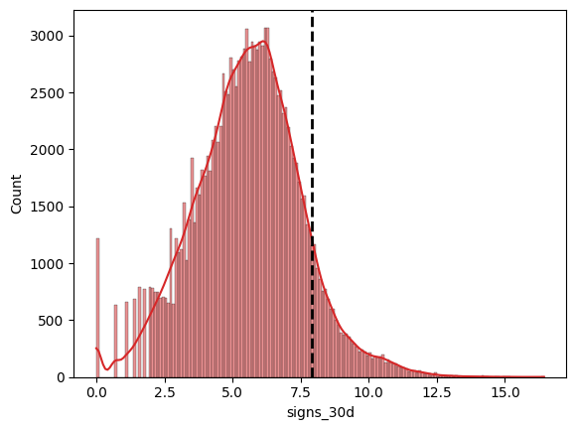
Creating a Success Metric
Existing ‘status’ column does not always signify high success
Success metric:
Petitions with # of signatures after 30 days that are above the 90th percentile
Histogram of Log of Number of Signatures on Day 30 Among All Petitions
Background
Petition Analysis
Harmful Data
Challenges/Future Work
Notes:
Kristen - In the data given, there was a column called ‘status,’ which is defined as “the status of the petition as of now.” It could be saved, active, closed, or victory, but after running a quick analysis, only a small portion of the petitions were defined as victorious and it doesn’t always signify large growth/success. Some petitions with 10 signatures might be labeled as “victory.” To stay consistent, we decided to create our own success metric.

Slide 14
Factors of Growth
Polarity
Subject Matter
Model
01
Calculated if petition descriptions had a “positive, negative, or neutral” sentiment
02
Identified the most important keywords amongst petitions
03
Experimented with various types of model to find the best predictor of petition success
Background
Petition Analysis
Harmful Data
Challenges/Future Work
Notes:
Kristen - Before getting into the details of our success metric, I will introduce the three main methods of analysis we conducted on the petition data to measure factors of growth.
Check the last one, idk if we added that to slide deck
Make sure to talk about why this is important

Slide 15
Polarity Score
Measures the overall sentiment of a particular text, ranged from [-1.0, 1.0] with -1.0 being negative and 1.0 positive.
Background
Petition Analysis
Harmful Data
Challenges/Future Work
Notes:
Preetha
Used polarity scores to conduct some analysis on the overall sentiments of each petition ‘description’
Used a package called NLTK Vader which is is a lexicon and rule based sentiment analysis tool specifically calibrated to sentiments most commonly expressed on social media platforms
Vader outputs 4 metrics: compound, negative, neutral, and positive
The compound score calculates the sum of all lexicon ratings which is normalized between -1 (most negative) and +1 (most positive).
Positive, negative, and neutral represent the proportion of the text that falls into these categories

Slide 16
Polarity Scores
POSITIVE SENTENCE:
"Petitions empower communities and foster change by enhancing voices of individuals hoping for a better world."
Polarity score:
{'neg': 0.0, 'neu': 0.695, 'pos': 0.305, 'compound': 0.6908}
NEGATIVE SENTENCE:
“Petitions can be disregarded and face obstacles, dampening the hopes of those seeking meaningful change.”
Polarity score:
{'neg': 0.244, 'neu': 0.516, 'pos': 0.239, 'compound': -0.0258}
Background
Petition Analysis
Harmful Data
Challenges/Future Work
Notes:
Preetha:
As an example, we can see for the positive sentence, it has a proportion of 0 negative words, 0.695 for neutral and 0.305 for positive, thus making it a positive statement in its compound score of 0.6908
Same for negative sentence, since it has a larger proportion of negative and neutral words in its text, it leans slightly below 0 towards a negative/neutral statement

Slide 17
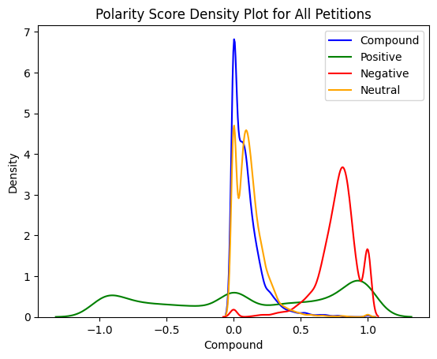
Polarity Scores
Compound: central around 0, leaning towards more positive
Positive: low, but spread throughout most petitions
Negative: skewed to the right
Neutral: similar to compound
Kernel Density Plot of Polarity Score on 10,000 randomly sampled rows
Background
Petition Analysis
Harmful Data
Challenges/Future Work
Notes:
Preetha
Thus, we made a visualization using a kernel density plot to represent the probability density function of the continuous variable of the compound, pos, neg, and neu values
is analogous to a histogram but uses a continuous curve to represent the distribution of the data
For the following data visualizations, we used a random sample of 10,000 rows across all datasets to get a more representative visualization of the data
On the x-axis we can see the possible range of the polarity score, from -1 to 1, y-axis represents the density of each score value
Analysis:
Compound around 0 but leaning positive, meaning overall the petitions had a neutral or slightly positive sentiment and wording, could possibly be to encourage more signatures
Positive is low but spread throughout most petitions
Negative is skewed right, meaning there was a higher density of negative wording in petitions
Neutral is similar to compound, which can be explained by the fact that as seen in the previous slide, the pos/neg values aren’t usually as large as the neu proportion, so the neu affects the compound score more than the pos/neg values

Slide 18
Polarity Scores
Example Table:
10% of petition descriptions have polarity score = -1.0
Changes with random sample
There existed petitions that contained spam content
Might skew the polarity scores for petitions
Title | Description
<: aaa | aaa
MLB: Get MLB to remove… | Let Pete back in baseball!
Yes | Its me
Background
Petition Analysis
Harmful Data
Challenges/Future Work
Notes:
Preetha
Additional analysis showed that only 10% of the petitions had a negative polarity score of -1, meaning that very few were extremely strongly negatively worded which had the potential to be harmful
However, we noted as we looked through the table of petitions that there were petitions that could be potentially tagged as spam content, so it’s important to note that the existence of spam petitions might’ve skewed the polarity scores and therefore our prediction model in the future

Slide 19
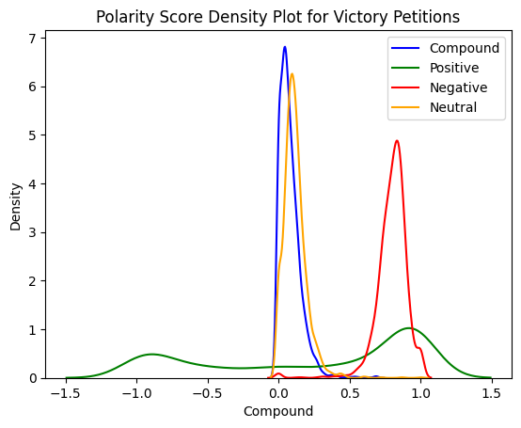
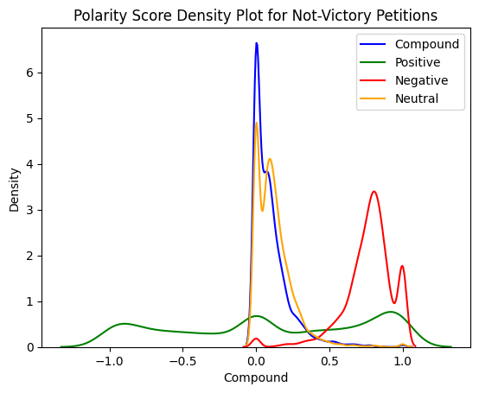
Polarity Scores
Factors of High-Signature Petitions:
Strong wording
Acting against or preventing something
‘Successful’ Petitions
‘Unsuccessful’ Petitions
Background
Petition Analysis
Harmful Data
Challenges/Future Work
Notes:
Preetha
Visual representation of the KDE plots for polarity scores separated into successful and unsuccessful petitions (based on our 90% threshold metric)
Both seem to have a compound score near 0, and same with neutral, which could be explained by the previous reasoning of more descriptions having a larger proportion of neutral wording compared to positive and negative wording
Victory petitions have a higher proportion of both positive and negative words than non-victory petitions, which could mean that more strongly worded petitions lead to more interaction with the petition and more signatures
Interesting to node that there is a higher density of negative scores in particular, could mean that petitions with stronger negative wording, or petitions against or preventing some action are more likely to gain signatures

Slide 20
Keyword Extraction
with Yake:
Yet Another Keyword Extractor
“unsupervised automatic keyword extraction method”
Background
Petition Analysis
Harmful Data
Challenges/Future Work
Notes:
Vikash - YAKE, which stands for 'Yet Another Keyword Extractor', is an unsupervised, automatic keyword extraction algorithm. It works by analyzing the frequency of word occurrence and its distribution throughout the document. Unlike other keyword extraction techniques, YAKE does not need any training data. Instead, it focuses on the statistical properties of the words within the document itself.

Slide 21



Text Pre-Processing
2. Feature Calculation
3. Keyword Scoring
cleaning and normalizing the text, tokenizing text
calculating term frequency, position of word, degree of word
calculate score based on steps 1 & 2
Background
Petition Analysis
Harmful Data
Challenges/Future Work
Notes:
Vikash
The process follows three main steps:
a. Text pre-processing: It begins by cleaning and normalizing the text, followed by tokenization which breaks down the text into individual words or 'tokens'.
b. Feature calculation: For each candidate keyword, YAKE calculates several features such as term frequency, position of the term in the document, and the degree of the term. The degree represents the sum of the co-occurrence weights of a term with other terms.
c. Keyword scoring and ranking: YAKE then calculates a score for each candidate keyword based on the calculated features. The keywords with the lowest scores are considered the most relevant.

Slide 22
Yake
in action
“Save the Gibson House Museum”
“Gibson House Museum” | 0.0007
“Park” | 0.206
“Criminal” | 0.588
“Stop the "Adventure Park”
“Make BULLYING a criminal offense”
Deduplication Threshold: 0.1
Max # of Words per Keyword: 3
Language = English
*low deduplication due to the smaller example
Background
Petition Analysis
Harmful Data
Challenges/Future Work
Notes:
“Gibson House Museum”
0.0007
“Criminal”
0.588

Slide 23
Yake
ask column
animal | 0.175
kids | 0.174
Home | 0.169
Give | 0.168
Parents | 0.162
MOD | 0.0034
states | 0.0034
time | 0.0033
National | 0.0032
ENDLESS | 0.0032
Top 5 Successful Keywords
Top 5 Unsuccessful Keywords
Background
Petition Analysis
Harmful Data
Challenges/Future Work
Notes:
Vikash - Moving on to our project, we used YAKE to extract the most relevant keywords from the title of each petition in our dataset. After running our titles through YAKE, we obtained a list of keywords for each title.
We then aggregated these keywords across all titles, keeping a count of the frequency of each keyword. These frequency counts served as the basis for our word cloud.
A word cloud is a visual representation of text data, where the size of each word indicates its frequency or importance. Therefore, the most frequently occurring keywords, extracted by YAKE, appear larger in the word cloud.
By presenting our keywords in a word cloud, we can quickly understand which words or themes are most common in our petition titles. This provides a visually appealing and accessible way to understand the main themes across our dataset, which could be informative for further analysis or model development.

Slide 24
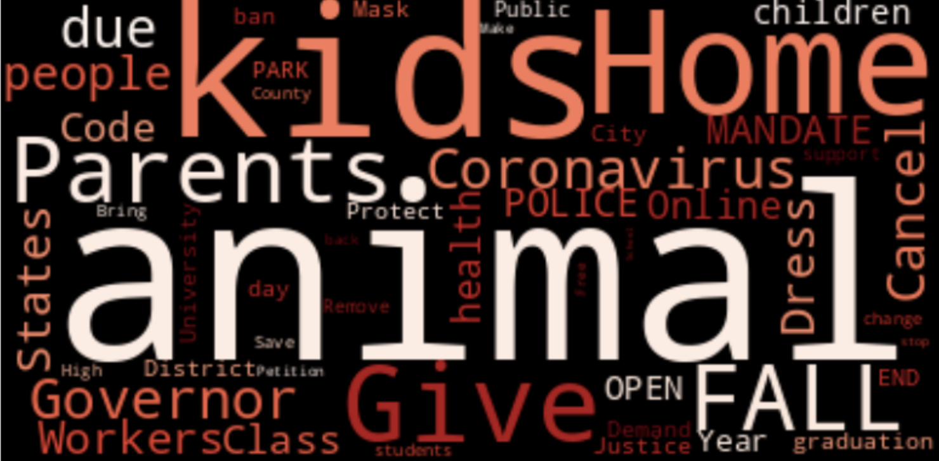
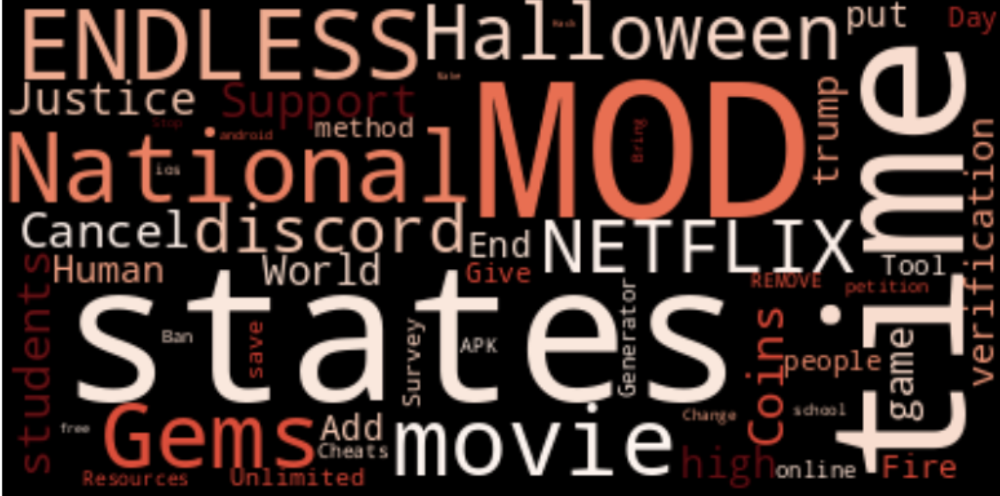
Yake WordClouds
ask column
Successful Petitions
Unsuccessful Petitions
Background
Petition Analysis
Harmful Data
Challenges/Future Work
Notes:
Vikash - Moving on to our project, we used YAKE to extract the most relevant keywords from the title of each petition in our dataset. After running our titles through YAKE, we obtained a list of keywords for each title.
We then aggregated these keywords across all titles, keeping a count of the frequency of each keyword. These frequency counts served as the basis for our word cloud.
A word cloud is a visual representation of text data, where the size of each word indicates its frequency or importance. Therefore, the most frequently occurring keywords, extracted by YAKE, appear larger in the word cloud.
By presenting our keywords in a word cloud, we can quickly understand which words or themes are most common in our petition titles. This provides a visually appealing and accessible way to understand the main themes across our dataset, which could be informative for further analysis or model development.

Slide 25
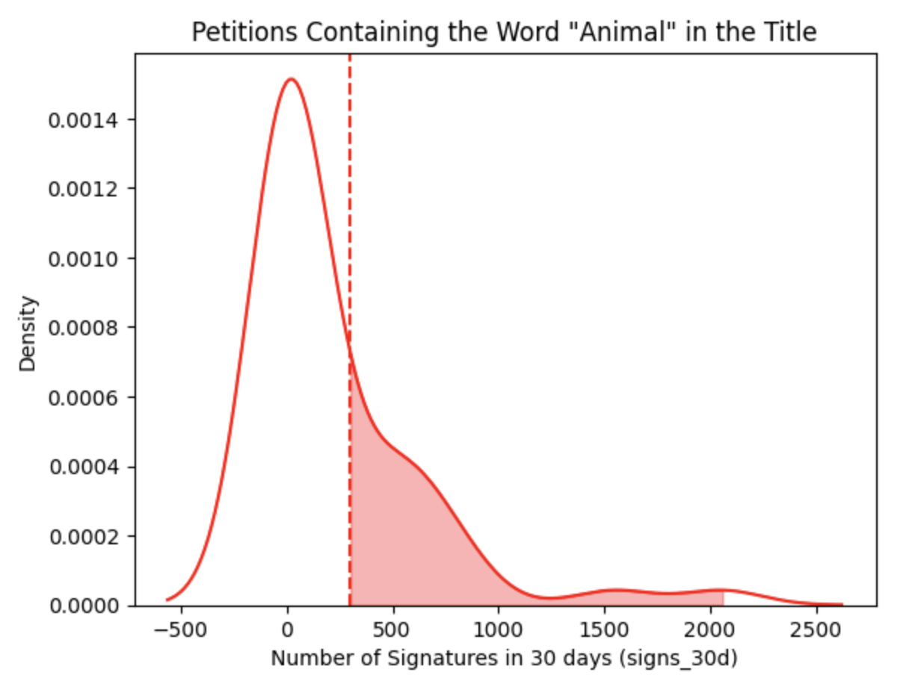
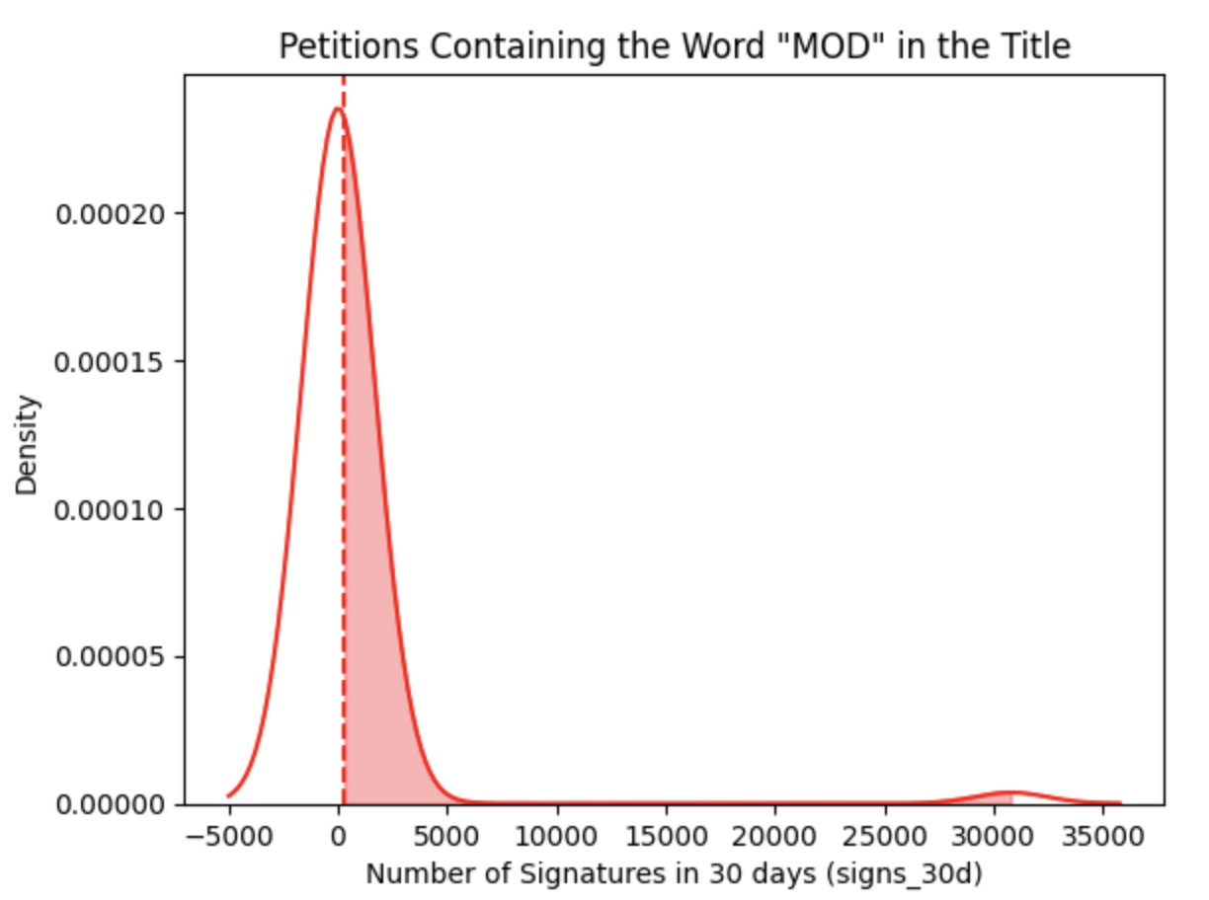
Validating Success w/ Yake
Type: Successful Keyword
Success Rate: 0.255 or 25.5%
Type: Unsuccessful Keyword
Success Rate: 0.034 or 3.4%
Background
Petition Analysis
Harmful Data
Challenges/Future Work
Notes:
Vikash
The process follows three main steps:
a. Text pre-processing: It begins by cleaning and normalizing the text, followed by tokenization which breaks down the text into individual words or 'tokens'.
b. Feature calculation: For each candidate keyword, YAKE calculates several features such as term frequency, position of the term in the document, and the degree of the term. The degree represents the sum of the co-occurrence weights of a term with other terms.
c. Keyword scoring and ranking: YAKE then calculates a score for each candidate keyword based on the calculated features. The keywords with the lowest scores are considered the most relevant.

Slide 26
Regression Models
Input petition features and predict the # of signatures after 30 days
Linear
Poisson
Negative
Binomial
Pro:
Very high accuracy
Training R² = 0.8396
Testing R² = 0.8586
Con:
Could be overfitting
Pro:
Accounts for overdispersion
Con:
Needs more data & text variables
Pro:
Useful for non-normal distributions
Con:
Assumptions not met due to overdispersion
Background
Petition Analysis
Harmful Data
Challenges/Future Work
Notes:
Vikash - handling overdispersion, poisson assumes mean and variance are equal, nb doesn’t takes into account as another variable.
Explored 3 diff models to predict whether a petition would be successful or not, according to our success metric
Decided to use a regression model instead of a classification model since we were uzing a numeric cutoff as our success metric
Pipeline is: our model predicts the number of signatures after 30 days, and we then determine whether it passes the 90% threshold after which we classify it as a success or not

Slide 27
Key Takeaways: Linear Regression
Accuracy of predicting successful petition: 85.86%
Training accuracy is smaller than testing indicating that the model is good predictor for the data
High correlation between signs_30d and signs_7d compared to other predictors
Additional influential features needed to decrease weight of single predictor
Used solely numerical variables, could improve accuracy through categorical (such as user/staff tags)
Background
Petition Analysis
Harmful Data
Challenges/Future Work
Notes:
Preetha

Slide 28
Analysis of Features: Neg Binomial
Feature | 7-Day Signatures | 1-7 Day Signatures Ratio | Compound Ask Polarity Score | Number of User Tags | Number of Profanity Words | Amount of Punctuation | Ask Length
Weight in Model | 0.002 | 0.050 | 0.285 | 0.027 | -1.358 | -0.001 | 0.014
p-value | ~~0 | ~~0 | ~~0 | 0.109 | ~~0 | 0.868 | ~~0
Weights: average change of ‘30-Day Signatures’ associated with a one unit increase in each feature
Background
Petition Analysis
Harmful Data
Challenges/Future Work
Notes:
Kristen - Here, we added two useful measures of how statistically significant features might be. After running our negative binomial regression, you can see the outputted weight of each variable on the target. This may be a lot to look at, but you can see that different features had almost no effect on the outcome of signs_30d, while others had a larger impact. We also had other features that we didn’t include because they did not work, but you can see them in the appendix if you are interested.

Slide 29
Analysis of Features
Strong Features
7 Day Signatures
1-7 Day Signatures Ratio
Compound Ask Polarity Score
# of Profanity Words
Ask Length
Has either a staff tag or user tag
Has a photo
Weak Features
Number of User Tags
Amount of Punctuation
Description Length
Having zero signatures at
7 Days
Background
Petition Analysis
Harmful Data
Challenges/Future Work
Notes:
Kristen

Slide 30
Key Takeaways:
Negative Binomial Regression
Accuracy of predicting successful petition: 0.8128%
We found some good features!
*Not consistent with every random sample
Log-likelihood is very small indicating that the model is poor fit for the data
Used a Frequentist approach, could have more potential with a Bayesian approach
Updating beliefs using observed data
Background
Petition Analysis
Harmful Data
Challenges/Future Work
Notes:
Kristen

Slide 31
03
Harmful Petitions
Notes:
Pujitha

Slide 32
Harmful Petitions - Background, Thought Process
1
“Harmful” / “Abusive” Meaning?
2
The Complexity of “Harm”
4
Minimizing Flagging of Good Petitions
3
Freedom of Speech
Background
Petition Analysis
Harmful Data
Challenges/Future Work
Notes:
Pujitha
Before we dive into the data analysis, I wanted to give an overview of the thought process, research, and more conceptual considerations that went into this portion of the project.
Point 1
(general) Looked at Change.org existing guidelines, saw that they have guidelines but not explicitly an accountability/checking method actually in place ⇒ only thing is if a USER decides to report it
They don’t have much metric themselves
Then, we looked at the data and saw data-wise it doesn’t tell us much since there were very few petitions to begin with which fell under the abuse mitigation data, and even among those that did, 4 / 5 of them I believe were just spam, not harm.
So then we realized if we don’t have Change.org guidelines or the data telling us, it was truly up to us to conceptually determine what harm means.
Gives us a lot of power as data scientists.
Point 2
Point 2: “harm” is so complex, cannot necessarily create 1 single algorithm, do 1 kind of analysis which will help us investigate all kinds of themPoint 3: freedom of speech, big consideration. Freedom of speech is always important, but SPECIFICALLY IN THIS CONTEXT, as crucial freedom of speech is to movement building, harmful rhetoric can just as easily tear them down, create resentment, and discouragement. A consideration is to what extent regulation should occur. Currently, our take is that slightly more regulation – based on community guidelines of Change.org, seems to be limited
Point 4: An example of how freedom of speech can be hampered is good petitions being flagged as harmful. For ex: a petition talking abt racial violence vs a petition trying to incite racial violence. Both petitions would have rhetoric of racial violence, which is obviously a negative thing, but it’s incredibly important only the latter is removed.
Otherwise, we would literally accidentally be silencing movements. Could discourage activists to use strong language (ex: about racial violence) if they start seeing that their petition is taken down/for review. And strong language/rhetoric/communicating ideas and stories is at the heart of stirring sentiment among the public and getting support for movements.
. Additionally, even though we found the Google Perspective Artificial Intelligence tool, (will discuss more soon), this tool itself has faced substantial criticism ⇒ one of the drawbacks of this tool is actually one of our own concerns, point 4
“Another issue was that the algorithm learned to conflate toxic comments with nontoxic comments that contained words related to gender, sexual orientation, religion or disability. For example, one user reported that simple neutral sentences such as “I am a gay black woman” or “I am a woman who is deaf” resulted in high toxicity scores, while “I am a man” resulted in a low score.” https://www.scientificamerican.com/article/can-ai-identify-toxic-online-content/
End - Overview of Data Analysis that is to Come 1. Overview of what we ended up doing:
Used Perspective tool + Profanity Database
The main Change.org data for which there were any significant amount of petitions for the abuse mitigation data was “hidden” (comments_disabled, mitigation_banner had none for the initial 1000 → potentially were there in the full million dataset, but at that point we were already underway with our plan) ⇒ so this is attribute we focused on.
Factors into play vs facets of harm/abuse
Looked at Change.org’s policy too, saw it was a bit loose

Slide 33
Overview of Our Data Analysis
Notes:
Pujitha (just split this into a new slide)
End - Overview of Data Analysis that is to Come 1. Overview of what we ended up doing:
Used Perspective tool + Profanity Database
The main Change.org data for which there were any significant amount of petitions for the abuse mitigation data was “hidden” (comments_disabled, mitigation_banner had none for the initial 1000 → potentially were there in the full million dataset, but at that point we were already underway with our plan) ⇒ so this is attribute we focused on.

Slide 34
Perspective API
Background
Petition Analysis
Harmful Data
Challenges/Future Work
Notes:
Sooyeon

Slide 35
Toxicity Scoring
Identify and filter online content that may be considered "toxic" or harmful
Natural language processing (NLP) algorithms to analyze text and assign a toxicity score
Returns probability (0-1) of the content containing abusive, threatening, or offensive language
Text: | Toxicity Score:
“Safety in Rockingham County Public Schools” | 0.006345861
“Derek should shut the f*ck up❤️” | 0.9029226
Background
Petition Analysis
Harmful Data
Challenges/Future Work
Notes:
Sooyeon
Maybe bring up exactly what u said in 5/1 meeting → why Yake doesn’t work and Perspective needed

Slide 36
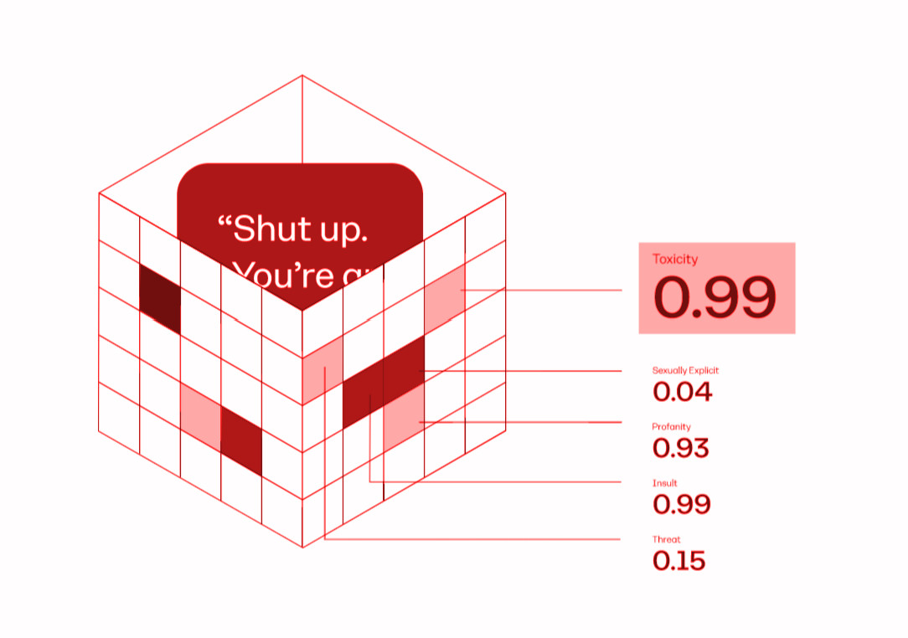
How Perspective API Works
1
Severe toxicity
4
Identity Attack
2
Insult
5
Threat
3
Profanity
6
Sexually Explicit
Background
Petition Analysis
Harmful Data
Challenges/Future Work
Notes:
Pujitha
https://www.perspectiveapi.com/how-it-works/

Slide 37
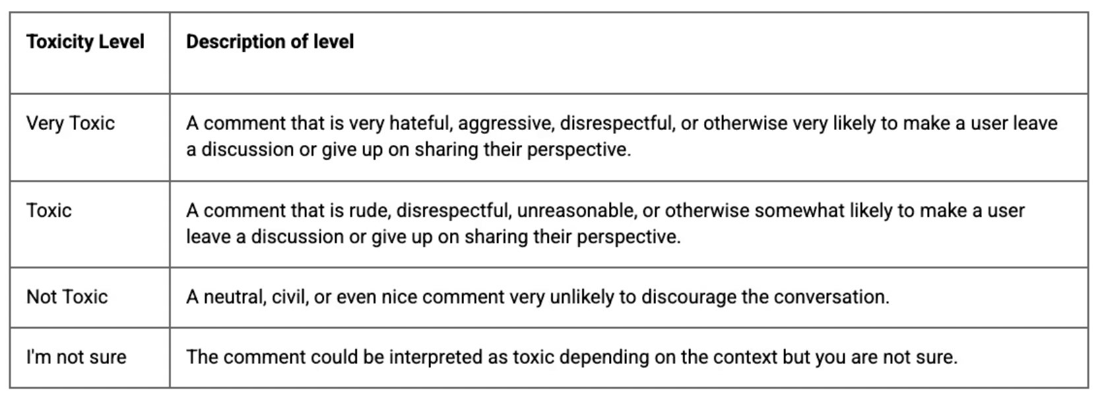
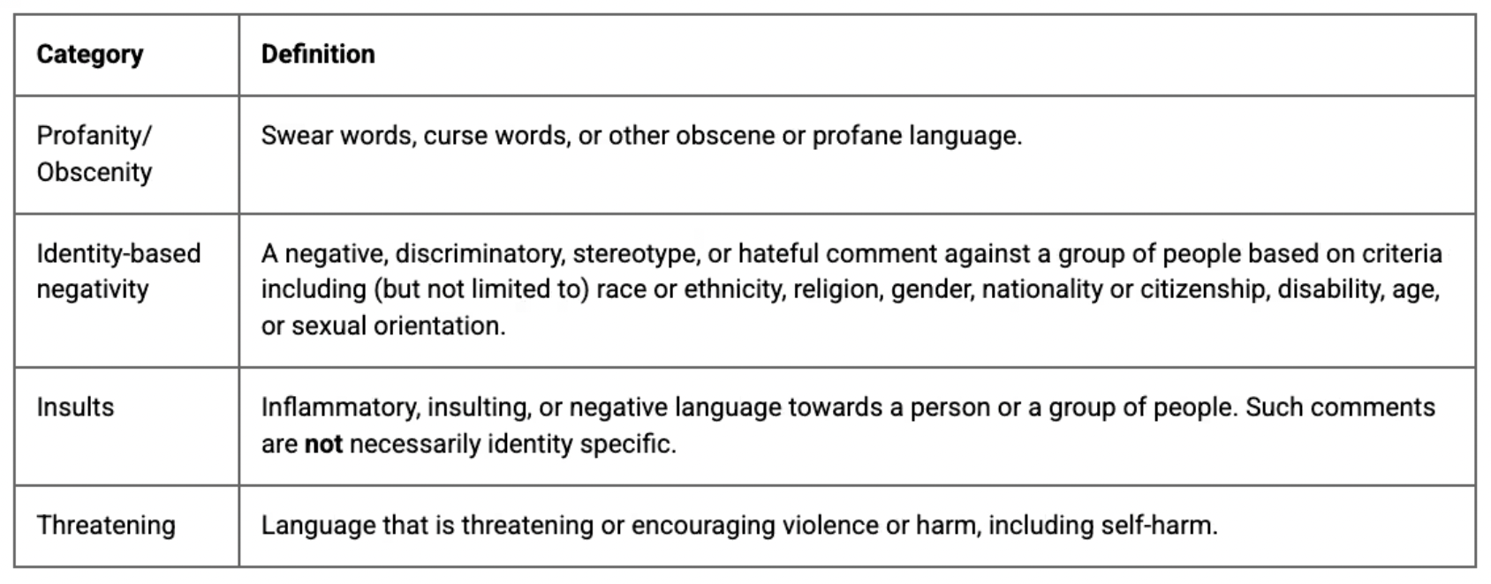
Categories as defined by Perspective API
Background
Petition Analysis
Harmful Data
Challenges/Future Work
Notes:
Sooyeon

Slide 38
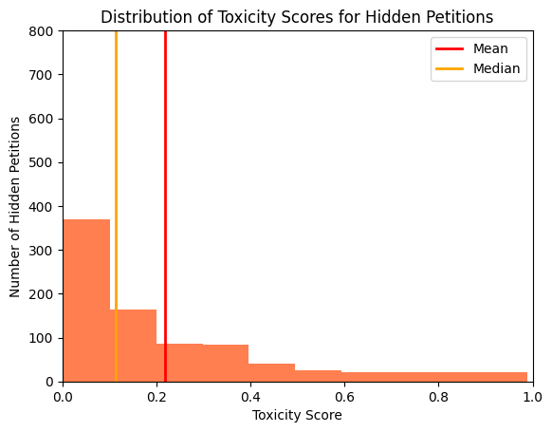
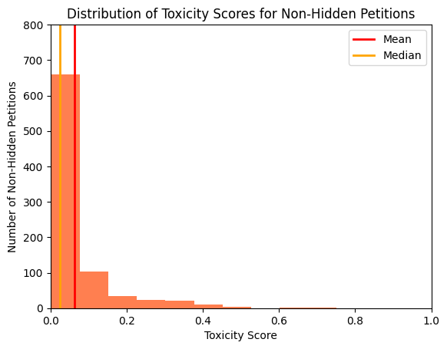
Hidden vs. Non-Hidden Toxicity Scores
Mean: 0.218
Median: 0.114
Mean: 0.062
Median: 0.025
Background
Petition Analysis
Harmful Data
Challenges/Future Work
Notes:
Sooyeon
Is orange line too hard to see?

Slide 39
0.1549 - 0.1562
Difference between hidden and
non-hidden toxicity scores

Slide 40
Challenges:
Future Exploration:
01
Not openly accessible to use: must request access from Google
Server request error: standard API Package cannot process large-scale requests
02
Use as a feature, linear modeling
Background
Petition Analysis
Harmful Data
Challenges/Future Work
Notes:
Sooyeon

Slide 41
Profanity Exploration
Background
Petition Analysis
Harmful Data
Challenges/Future Work
Notes:
Pujitha
Profanity Database: https://github.com/surge-ai/profanity

Slide 42
Petitions with 1+ Profanity Word (1 sample)
46/826 = 5.7%
44/9084 = 0.5%
hidden
non-hidden
Background
Petition Analysis
Harmful Data
Challenges/Future Work
Notes:
Pujitha
Turn code cell into bullet point or table - NO CODE
Slides formatting
Less words on slide
Still more steps we can take here,
Provides more evidence for how – Maybe “hidden” is not a good metric, as Sooyeon showed with the distribution
Potentially using Perspective as the metric
If petitions have ___
TO DO
Use perspective as the harmful threshold
More on takeaways → IMPLICATION of what we’ve presented:
“Hidden” may not be best metric
Are non-harmful petitions being hidden?

Slide 43
Petitions with 1+ Profanity Word: Bootstrap
~ 5.3-5.6% difference
[5.80%, 5.99%]
[0.37%, 0.42%]
hidden
non-hidden
Hidden petitions are ~13-15 times more likely to have 1+ profanity word (95% confidence, 200 samples, 10000 rows)
Background
Petition Analysis
Harmful Data
Challenges/Future Work
Notes:
Pujitha
When we used a technique called bootstrapping, which is essentially finding the same value except for 200 samples of petitions rather than 1 sample, we found:
For hidden petitions, the percent with profanity falls between around 5.8-6%
For non-hidden, the percent with profanity is < 1%
When bootstrapping, bootstrapped twice for 2 different test statistics, which are basically the metric we want to measure:
One was just percent difference, which we found was around 5% difference (top)
Other was the ratio → for which we found hidden petitions are 13-15x more likely to have profanity than non-hidden.
We wanted to give the bootstrap results of both test statistics so the 13-15x result isn’t taken out of context, and it’s kept in mind that as a whole, there wasn’t much profanity in general, even among the hidden petitions (only 5%). Still, when compared to non-hidden, this is fairly significant.
Hidden petitions are 13-15x more likely to have 1+ profanity word.

Slide 44
Synthesizing Results: Perspective + Profanity Analysis
Perspective Alone: reasonably large toxicity difference for hidden vs non-hidden
Profanity Analysis Alone: somewhat large profanity difference for hidden vs non-hidden
Perspective + Profanity Analysis: other factors may play larger role into “toxicity”/harm than profanity. Profanity alone may just be a small factor.
Notes:
So, we’ve given you a lot of information, both the results from the Perspective tool analysis for hidden/non-hidden petitions and also the results of our own analysis from scratch of Profanity for hidden/non-hidden petitions.
To synthesize these and draw some conclusions (which… are still yet to be developed since there’s much more analysis to be done), here are some interpretations.
Perspective Alone: reasonably large toxicity difference for hidden vs non-hidden (about a 15% difference)
Profanity alone: somewhat of a difference (5%) for hidden vs non-hidden.
Perspective + profanity: since the difference was higher for the perspective tool which takes into account more factors of harm than just profanity (like identity attack, threat, etc), this could indicate that when other factors are taken into account, then the petition is more toxic/harmful and thus hidden. We don’t know how MUCH each factor is contributing to toxicity, but collectively they are contributing a decent amount. Profanity alone seems to be only a small role.
Which brings me to the
Further exploration:
Can explore other facets of harm in depth such as identity attacks (race, and gender for ex), threat.
If there are other abuse mitigation data beyond “hidden”, can explore on those too.
Suggestion for Change:
Hidden doesn’t seem to be too strong of a metric for harmful petitions (ofc we don’t know if there’s other data/features other than what was given to us, but based on what we do have):
Change.org should have a feature more specifically tailored to harmful petitions ⇒ this way, harmful petitions can be filtered more easily and better addressed.

Slide 45
04
Challenges and Future Work
Notes:
Kristen

Slide 46
Challenges
Runtime
Modeling
Updating Data Pipelines
Defining Harmful
Large amount of data took an extremely long time to run through the cloud
Tested many different types of modeling before landing on final model
Had to update code with every new file of data sent
Had to research and define the boundaries of what makes content harmful
Background
Petition Analysis
Harmful Data
Challenges/Future Work
Notes:
Kristen

Slide 47
Next Steps
Improve NLP
Modeling
Server Change
Location Analysis
Create staff tags for every description
Unsupervised categorization to create tag categories for a semi-supervised model
Move work to platform with more computing power
Look more into how location impact petition signatures
Background
Petition Analysis
Harmful Data
Challenges/Future Work
Notes:
Preetha
To improve the NLP model and our use of YAKE, it would be useful for Change to create staff tags for every petition, and increase the number of user tags when users create a petition
This can help categorize each petition by the keywords extracted by Yake and analyze which category of petitions garners the most attention
We can improve our predictive model by using unsupervised categorization (such as YAKE) to create tag categories which we can then vectorize to use as a feature in a semi-supervised model to better predict the number of signatures at 30 days
It would also be useful to migrate our work from Deepnote to a platform with higher storage capacity and computing power, such as Google Colab or Jupyter Hub. Unfortunately for this project, due to security concerns, we were not able to do this, but this is something that Change can do with the code that we’ve provided
Finally, it would be interesting to look more into how specific locations impact the number of signatures and overall viewership of the petitions. Simply due to time we were unable to get to this and did our analysis solely on petitions written in english, but this would be an interesting avenue to explore further.

Slide 48
Key Takeaways
Petition Analysis
Predicting Success
Harmful Data
Best Features Associated with Success:
7 Day Signatures
Compound polarity score
Best Models:
Negative Binomial
Linear Regression
Harm is multifaceted
‘Hidden’ should be examined further as a metric of harm
Toxicity scores may be good indicators of harm
Background
Petition Analysis
Harmful Data
Challenges/Future Work
Notes:
Natraj

Slide 49
Thank you!
Questions?
Notes:
Nikki

Slide 50
Appendix
Slides We Didn’t Present

Slide 51
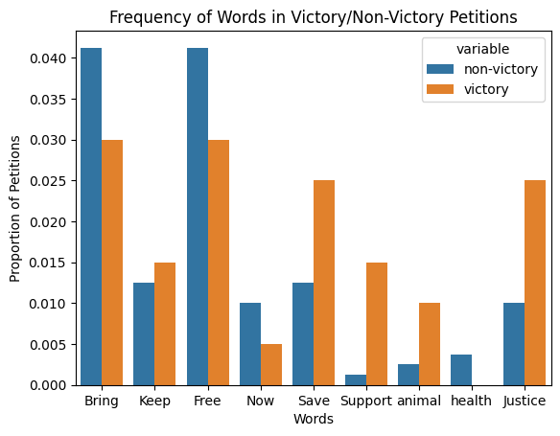
Word Frequency
Titles of Petitions: ‘ask’
Looking for visual comparisons between proportion of petitions
Themes among successful petitions
Keep, Save, Support, Animal, Justice
Background
Petition Analysis
Harmful Data
Challenges/Future Work
Notes:
Vikash
This is what we got from using Yake

Slide 52
Analysis of Features: Neg Binomial
Feature | 7-Day Signatures | 1-7 Day Signatures Ratio | Compound Ask Polarity Score | Number of User Tags | Number of Profanity Words | Amount of Punctuation | Ask Length
Correlation w/ 30-Day Signatures | 0.893 | 0.102 | -0.005 | 0.166 | 0.007 | 0.036 | 0.060
Background
Petition Analysis
Harmful Data
Challenges/Future Work

Slide 53
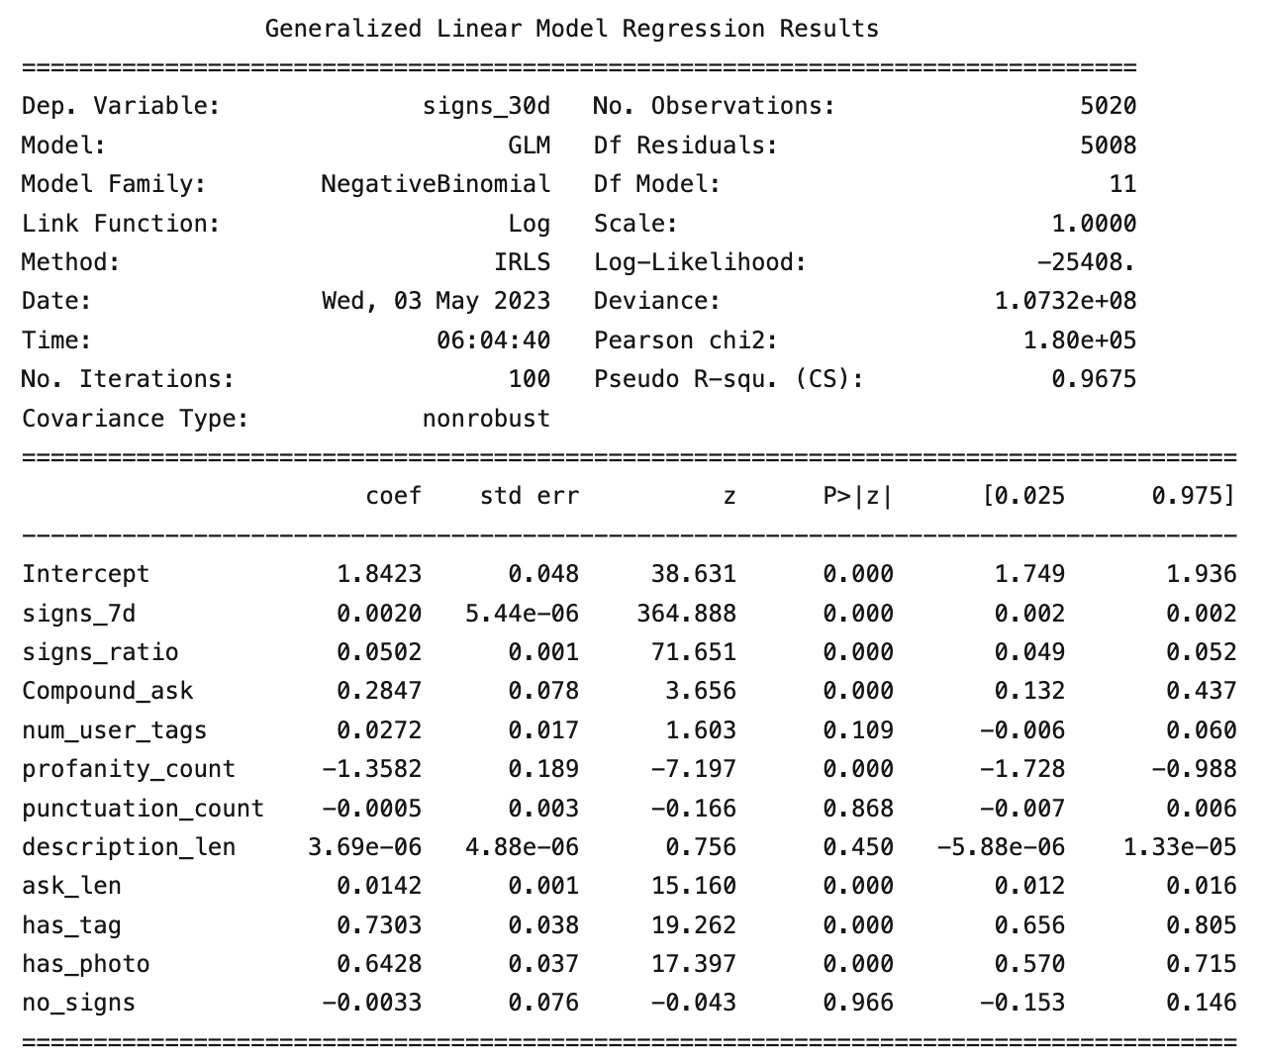
Analysis of Features: Neg Binomial
Log-likelihood very low, indicating poorly fitted model.
Background
Petition Analysis
Harmful Data
Challenges/Future Work

Slide 54
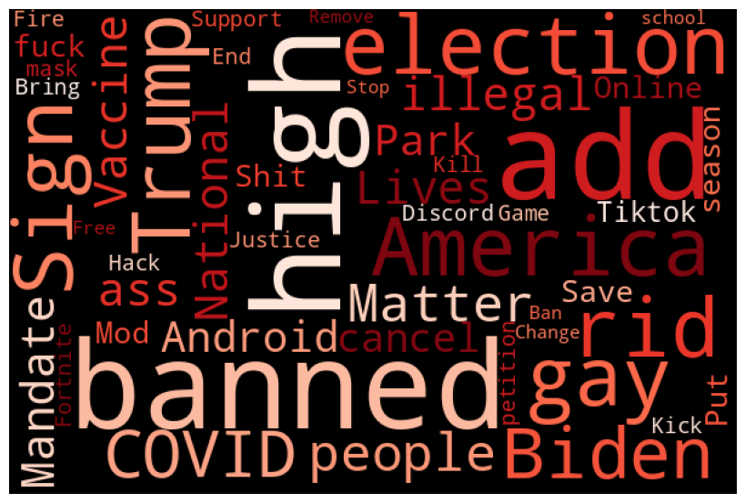
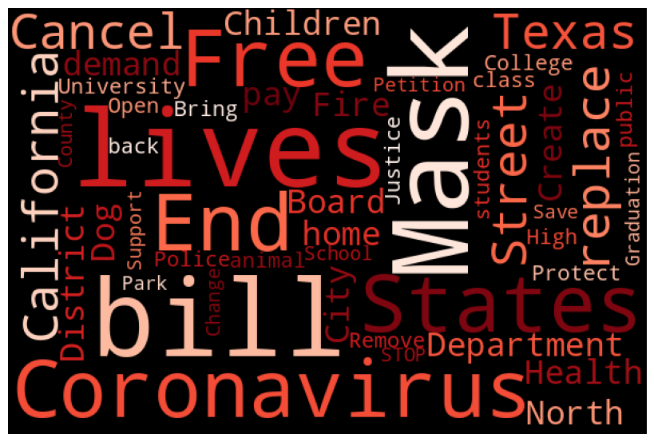
Word Cloud: Hidden vs. Non-Hidden
Hidden
Non-Hidden

